Slide 1

YEAR 7 CURRICULUM MAP
The progressive, inclusive curriculum ‘skills, knowledge and concepts: literacy, life skills and enrichment’
 | Autumn 1 Year 7
Autumn 1 – 7 weeks Literacy / foci Reading Structured writing Definition – religious literacy Numeracy Historical event dates List most/least important Homework Memory Lane – Create Revisiting, revising, remembering opportunities questions S&C Do now's – retrieval Starter sentences revision before EOT assessment Feedforward - peer-marking Wider Reading Holi Colors by Rina Singh, The story of Diwali by Jatinder Verma | Unit 1: Festivals Assessment Objectives: -To be able to understand the festival of light within different cultures; Hinduism – Diwali and Holi Enrichment/life and work skills: Working practically in a team Communication skills Problem-solving Inquiry Skills CEIAG – tolerance and blending of different cultures across religion and British values. Religious festival requirements. Comparing the same festival within different parts of the world. Expansion of prior knowledge from KS2 Christianity and 1 other from SACRE’s. Focusing on Christianity and 2 others in first term. Assessment opportunities: Base Line test to close gaps from KS2 and KS3 and expand depth of knowledge. Sight any literacy issues and bring all students to one level of complete knowledge. Essay styled questions with Command words 5 Mark and 15 mark. An opportunity for all students to test and challenge at stages. Key Objectives: K01,2,3,4 & 5 7,8,9 SMSC – Community and faith links though different national and international festivals such as Diwali (London & India), Hanukkah and Christmas. Discussion and assembly for national holidays such as Black History Month. Promoted British Values: Individual liberty in regards to religion and Mutual respect and tolerance Extracurricular opportunities observing key festivals: Diwali - students feedback to the class
 | Autumn 2 Year 7
Autumn 2 (winter) – 8 weeks Literacy / Numeracy foci Reading Structured writing Essay writing Terminology & definition Numeracy Historical event dates List most/least important Homework Advent Calendar – Create Things to celebrate Hanukah Revisiting, revising, remembering opportunities questions S&C Do now's – retrieval Starter sentences revision before EOT assessment Feedforward - peer-marking | Unit 2: Festivals Assessment objectives: To be able to understand the importance of Hanukah and Christmas within Judaism and Christianity – Hanukah & Christmas Enrichment/life and work skills: Videos Group tasks Inquiry skills SACRE’s indication of Christianity from KS2 working with previous SACRE’s themes from KS2 and KS3. Assessments: Comparing 3 Festivals of Lights and their meaning. 5 mark and 15 mark questions Compare and contrast the importance of light within 3 main religions, reflecting on story telling Key Objectives: K01,2,3,4 & 5 - 7,8,9 Peer marked SMSC – Community and faith links though different national and international festivals such as Diwali (London & India), Hanukkah and Christmas. Discussion and assembly for national holidays such as Black History Month. Promoted British Values: Individual liberty in regards to religion and Mutual respect and tolerance Wider Reading A Christmas Carol by Charles Dickens, The Eight Nights of Hannukah by Judy Nayer Extracurricular opportunities observing key festivals: Christmas - student feedback to the class

Slide 2
YEAR 7 CURRICULUM MAP
The progressive, inclusive curriculum ‘skills, knowledge and concepts: literacy, life skills and enrichment’
 | Spring 1 Year 7
Spring 1 – 6 weeks Literacy / Numeracy foci Reading Structured writing Essay writing Definition Numeracy Historical event dates List most/least important Homework Family tree - Creative Revisiting, revising, remembering opportunities questions S&C Do now's – retrieval Starter sentences revision before EOT assessment Feedforward - peer-marking | Unit 3: Special People Assessment objectives: To understand the people of the book in both Islam and Christianity. To explore what they stood for and their symbolism in their faiths. Enrichment/life and work skills: Research skills Public speaking Inquiry skills CEIAG – Investigative work with knowledge of prophets from sacred text. Exploring the importance, they can have in today’s society. Analytical and Evaluative skills. Assessments: Who was Abraham? (5) Who was Moses? (5) Explain why the covenant (promises) are important in Judaism and Christianity. Refer to Abraham and Moses in your answer. (8) Key Objectives: K01,2,3,4 & 5 - 7,8,9 SMSC – Community and faith links though different people in the Abrahamic religions. Discussion of important roles people play in shaping our society. Promoted British Values: Individual liberty in regards to religion and Mutual respect and tolerance in regards to key religious figures. Wider Reading Abraham: A journey to the Heart of three faiths by Bruce Feiler Moses: A life by Jonathan Kirsch
 | Spring 2 Year 7
Spring 2 – 6 weeks Literacy / Numeracy foci Reading Structured writing Essay writing Definition Numeracy Historical event dates Chapter/verse page numbers (Bible) Homework Holy book Guide – Research and creative Revisiting, revising, remembering opportunities questions S&C Do now's – retrieval Starter sentences revision before EOT assessment Feedforward - peer-marking | Unit 4: Special Books Assessment objectives: To understand, compare and analyse different Holy books, showing how respect is shown throughout by religious believers. Focusing on Bible, Guru Granth Sahib and Qur’an Enrichment/life and work skills: Research skills Inquiry skills CEIAG – Investigative work with knowledge and stories from sacred text. SACRE’s indication of Christianity from KS2 working with previous SACRE’s themes from KS2 and KS3. Focus for Islam, Christianity and Sikhism. SMSC – Community & Faith links through different scriptures. Promoted British Values: Individual liberty in regards to religion and Mutual respect and tolerance of holy scriptures Assessments: Name 2 Holy books (2) (KO1) What is the importance of a Holy book to their followers? (5) Explain reasons why the Qur’an is not usually translated (5) (KO5) “Holy books are all basically the same” Discuss giving at least two Holy Books and how they are similar and different. Finish with a conclusion referring to the quote above. (15) Key Objectives: K01,2,3,4 & 5 - 7,8,9 Wider Reading Passages from the Quran and Bible

Slide 3
YEAR 7 CURRICULUM MAP
The progressive, inclusive curriculum ‘skills, knowledge and concepts: literacy, life skills and enrichment’
 | Summer 1 Year 7
Summer 1 – 5 weeks Literacy / Numeracy foci Reading Structured writing Essay writing Numeracy Historical event dates List most/least important Homework Research a holy places of worship you have never visited Revisiting, revising, remembering opportunities questions S&C Do now's – retrieval Starter sentences revision before EOT assessment Feedforward - peer-marking | Unit 5: Special Places Assessment objectives: To understand, compare and analyse different places of worship, showing how respect is shown throughout holy buildings. Focus on the Church, Mosque and Gurdwara. Enrichment/life and work skills: Research skills Public speaking Inquiry skills CEIAG – Investigative work with knowledge of features of places of worship. Exploring the importance of these special buildings in today’s society. Analytical and Evaluative skills. Assessments: Summative assessment at end of unit focusing on specific knowledge learnt, evaluation based question and comparative exam style questions. Shorter formative assessment throughout. Key Objectives: K01,2,3,4 & 5 - 7,8,9 SMSC – British values and what the British landscape looks like with multicultural and religious influences. Wider reading Christianity: the first 3000 years by Diamond MacCulloch Extracurricular opportunities Visiting the church
 | Summer 2 Year 7
Summer 2 – 7 weeks Literacy / Numeracy foci Reading Structured writing Essay writing definition Numeracy Historical event dates List most/least important Homework Write a brief history of your religion, including what led to its creation. Revisiting, revising, remembering opportunities questions S&C Do now's – retrieval Starter sentences revision before EOT assessment Feedforward - peer-marking | Unit 6: Create your own religion Assessment objectives: Students review knowledge and skills learnt throughout year 7 to create a temple, holy book and special item in a creative project. Enrichment/life and work skills: Group tasks (presentations) Research skills Public speaking Inquiry skills CEIAG – Investigative work on what brings a religion into existence. Analytical and Evaluative skills. Assessments: Presentation style assessment at end of unit giving a full overview. Students are encouraged to use the skills they have learnt throughout the year including comparison, analysis and evaluation. Summative end of year test during Year 7 assessment week (review of learning from year 7) Shorter formative assessment following each section (item, temple, book) Key Objectives: K01,2,3,4 & 5 - 7,8,9 Wider Reading The world Religions by Huston Smith

Slide 4
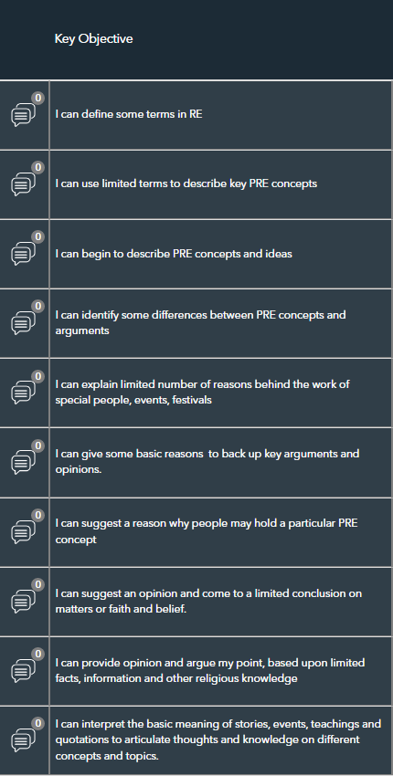
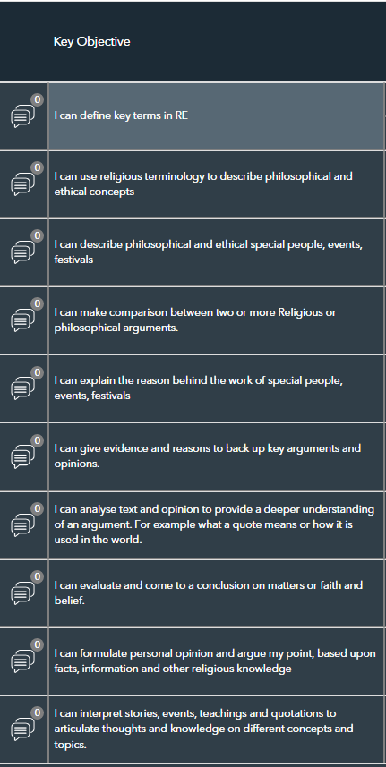
YEAR 7 CURRICULUM MAP
The progressive, inclusive curriculum ‘skills, knowledge and concepts: literacy, life skills and enrichment’
 | Year 7 KEY OBJECTVES – PATHWAY A
 | Year 7 KEY OBJECTIVES – PATHWAY B
 | )

Slide 5
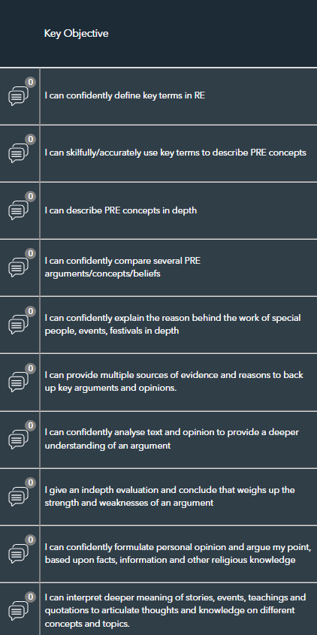
YEAR 7 CURRICULUM MAP
The progressive, inclusive curriculum ‘skills, knowledge and concepts: literacy, life skills and enrichment’
 | Year 7 KEY OBJECTVES – PATHWAY C

