Slide 1
UHS
Engagement
Evening
November 2017

Slide 2
Programme
5.15-5.45pm: Supporting your child through Year 11
5.45pm-7pm – preparing for specific curriculum exams. Lancaster building classrooms.
5:45-6:05pm- subject intervention 1
6:10-6:30pm- subject intervention 2
6:35-6:55pm - subject intervention 3

Slide 3






If not now, when?” …
“If not you, who?”
Notes:
We are using an analogy with sport. Aiming for students to view their exams as a performance and if they are going to achieve they will need to reach their peak in time for the summer exams. A few examples. In the Barcelona Olympics the Searle brothers said those statements to each other we’ve now adopted as a key message to the students. The great Britain women’s hockey team had a clear mantra in the 4 years leading up to their peak performance. Their mantra was to make history, be the best you can be for your team and inspire the future. Now UHS had good examination results with the outgoing year 11 in the summer. However, this cohort can make history again and achieve the best results in UHS history. However, the key to the success of the hockey team was preparation. We are also encouraging students to work for each other and motivate each other. In turn their actions will inspire the younger students at UHS. The image of the collective medals in Rio represents the need to set an audacious or ambitious goal. The GB team set a goal in Rio to outperform the number of gold medals they achieved in London and to the media and the general public they did this. In order to motivate we’ve also asked your young people to do a similar task. They have all written an audacious goal which we’ll be reviewing during the course of the year and then tweeting those who achieve these in the summer. Now the final images represent the reality. Year 11 will come with it’s ups and downs. It is a stressful time for teenagers who are having to deal with the pressure of a the most challenging exam systems of recent times and they are dealing with normal teenage anxst and emotions. So therefore we recognise that they’ll be ups and downs. However, there is a fantastic team of staff all of whom are here this evening to support them. They also have the people closest to them hear this evening and we’re relying on you to prop them up when the going gets tough and part of this evening is to let you know when those crucial times might occur, but also make suggestions for how you might wish to support.

Slide 4
Maximising Performance
It is probably true that when it comes to raising achievement, a “whatever it takes” mindset and culture is key.
Peak Performance
Goals
Mental health
Energy
Sleep
Safety
Rest & Recovery
Physical Activity
Nutrition

Slide 5
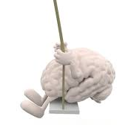


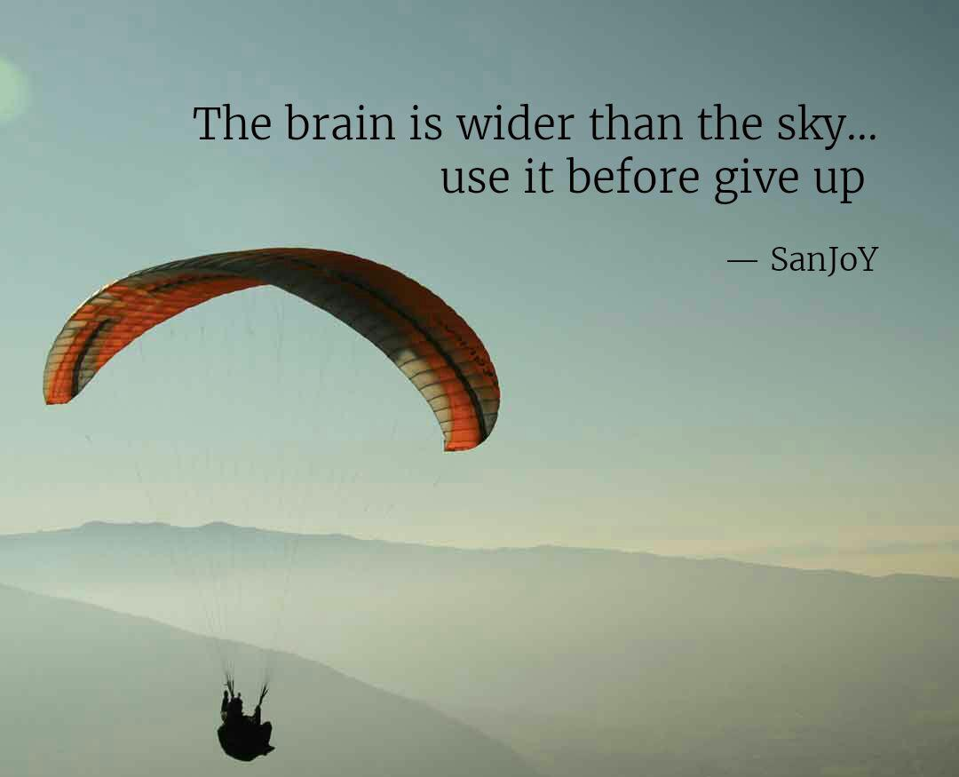
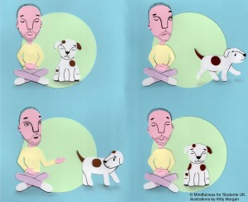

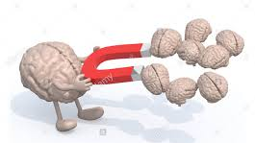

Slide 6

Year 11 Success Ladder:
Exams
Walking Talking
Mocks
May
Easter revision
DTT
Spring PPE-
April
February revision
Review goals & period 6 intervention
Feb/March
Jan/Feb
DTT
Autumn PPE-
Dec/Jan
Parents
Goals & period 6 intervention
Nov/Dec
October
Notes:
This model is designed to help you map out the year so you’re aware of what the young people will be preparing for during the course of the examinations. There will be two periods during the year where students to PPE’s which are past paper examinations. This is to ensure they have a like for like experience of what a GCSE examination paper and process is like. Think back to the visualisation of athletes if the young people have had experience of the real think it helps with their preparation and reduces their stress. In addition following these examinations we complete a question level analysis on the papers. These then allows for us to complete what we refer to as DTT. We diagnose areas of weakness either in a class across a cohort or with individual students. We then put in some therapy to address these weaknesses. This could be during lessons, for homework, period 6 intervention sessions. We will then re-test the areas of weakness. Talk through the other areas on the ladder.

Slide 7
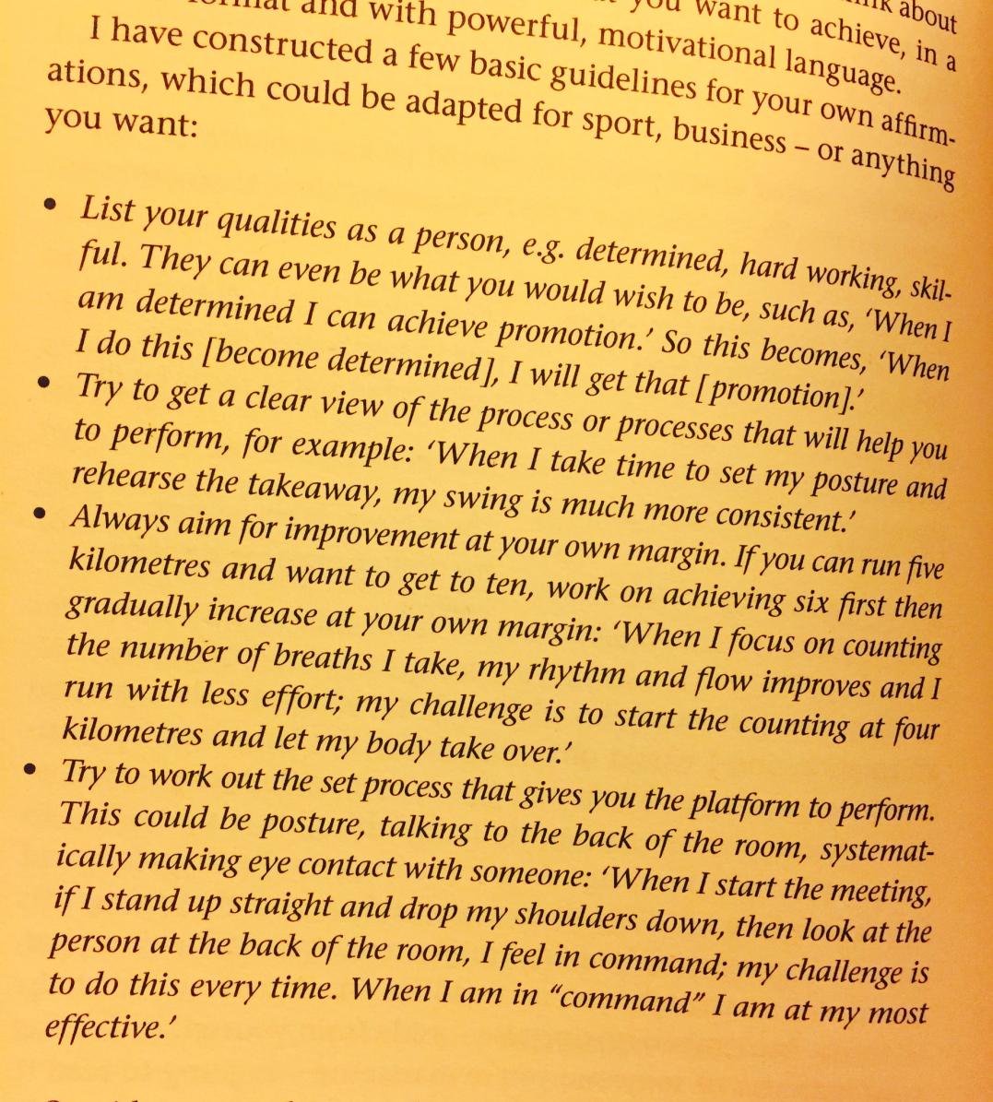
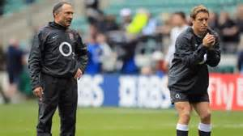
“Affirmations”
Qualities as a person
Clear view of process
Improvement at own margin
Process Platform to perform
You can’t do it yet
“Better than before…”
Notes:
Now I spoke to you at the start of this presentation about the need for students to be motivated. In order for this to happen they have to believe in themselves and they need us to support them with affirming their qualities and believing that what we’re asking them to do is possible. You may wish to go through the above steps with them and we will be asking tutors to work with them on this. It comes from the England rugby kicking coach who worked with one of the world’s most successful goal kickers Jonny Wilkinson. Once they understand their qualities and once they understand the process it will take to meet their goals this is what will provide them with the platform to perform.

Slide 8
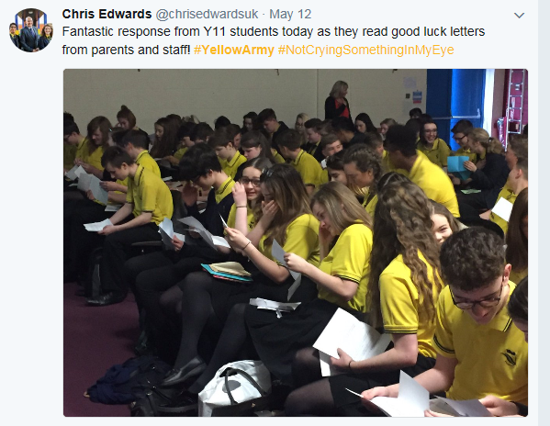
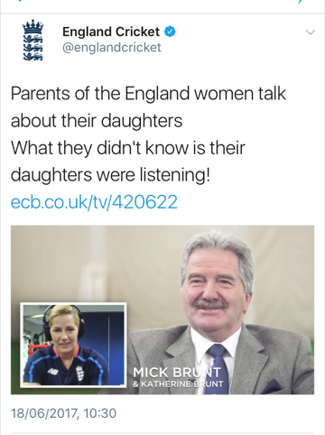
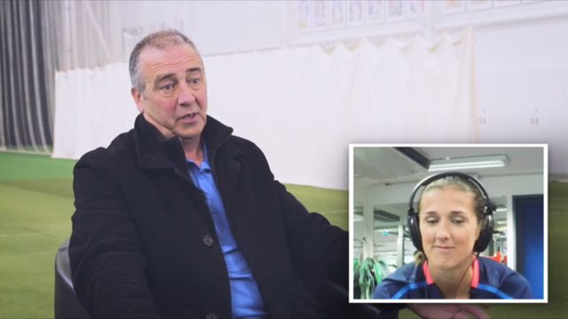
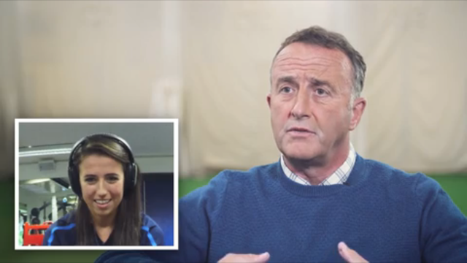
Notes:
This is where you come in. I’ve stolen an idea from a school who in turn stole the ide from the England women’s cricket team and it links with the theory regarding affirmation. The images you can see are of the fathers describing their daughters in doing so affirming their best qualities. When they were asked to do this they didn’t know that their daughters were listening and this was setup to support the female team’s performance. The way this adapted is that we’re going to ask you to write an affirming letter to your young person prior to their first exam and in a similar way to the image top left we’ll be getting them to open that letter just before their first exam in the summer. The exam experience can be stressful, last year we worked really hard to minimise this stress for example morning breakfasts, with teachers on hand to guide them and in some cases dress up in characters of a Christmas carol to help them remember the quotes. We had visual support material as they walked towards the exam halls. We had staff welcoming them and relaxing them, we had familiar voice recordings of staff reading the exam regulations, all small things added together to help reach their peak performance. This is one further step which we believe will aid this process.

Slide 9
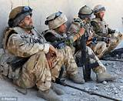
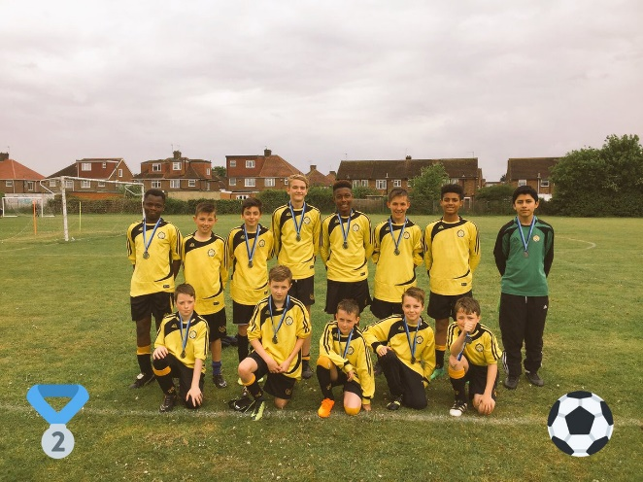
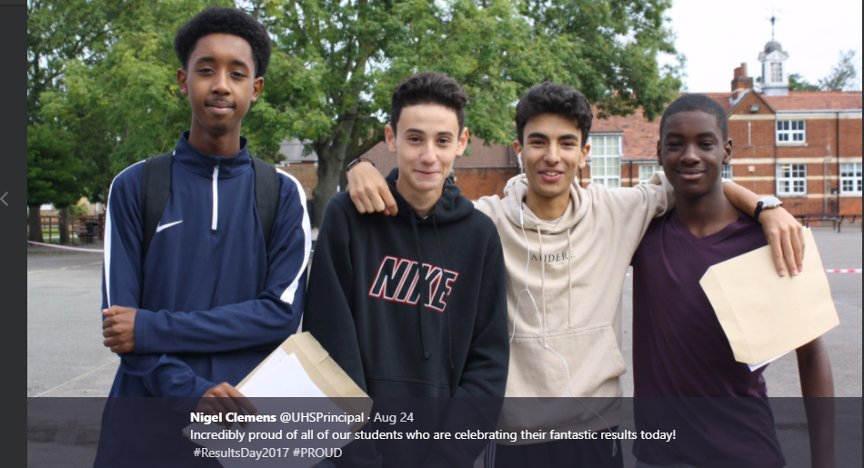
What if
We Learnt from the SAS
“Forget doing it for your nation.
You’re doing it for your mates. It’s a massive drive.”

Slide 10
Year 11 Key Dates:
Daily 3pm-4pm- Period 6 intervention.
Autumn PPE programme. 27/11- 15/12
Half termly progress reports
Controlled Assessment deadline: February
February Half term intervention programme: 12/02-14/02
Spring PPE programme 19/02-23/02
Easter Holiday Revision programme 10/04-13/04 (TBC)
Art Exam- Thu 11/Fri 12 May
GCSE Written Exams: Monday 14/05- 21/06.
Notes:
Explain in exam arrangements in relation to studying.

