Slide 1
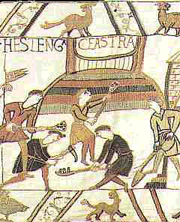
Why did William build castles in England?
Imagine you are the new King of England and you have decided to build a castle for your soldiers.
Think about the following things:

Slide 2
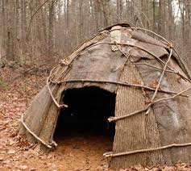
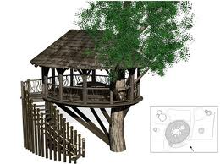
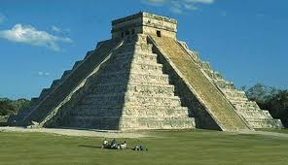
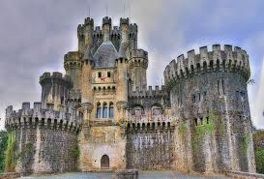
How would you keep your men safe?
Mud Hut
Tree House
Castle
Stone Temple

Slide 3
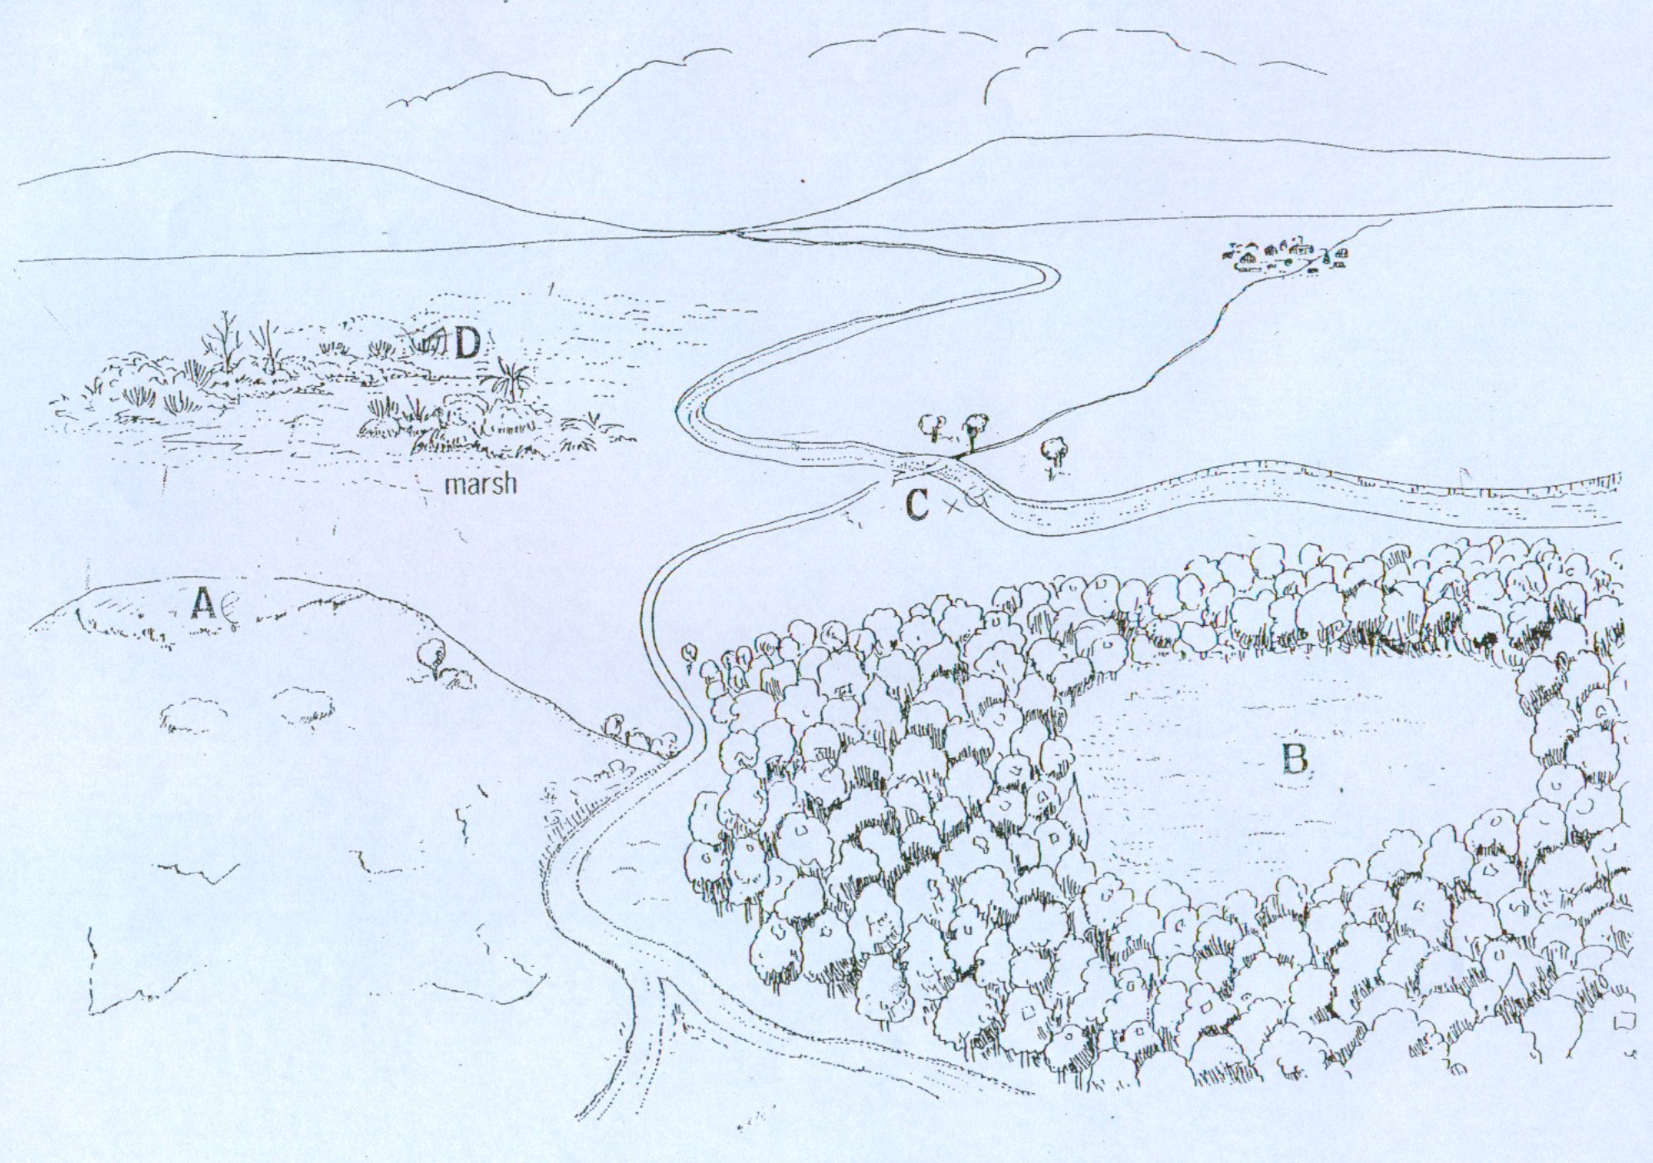
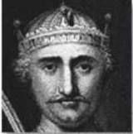
Where would you build your castle, and why?
D
OPEN COUNTRY
MARSH
C
A
HILL TOP
B
Where you would build your castle.
WOODED AREA

Slide 4

‘What features would you expect a castle to have?’

Slide 5
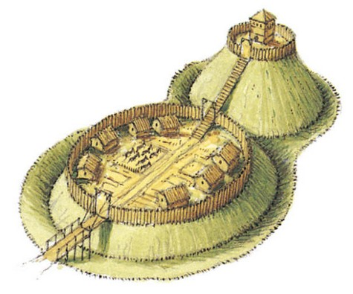
the keep
palisade
stairs
the motte
huts
the bailey
drawbridge
deep ditch
entrance
Task: to create a diagram or a 3D model of the castle you, King William, have created for your soldiers to keep them safe

