Slide 1
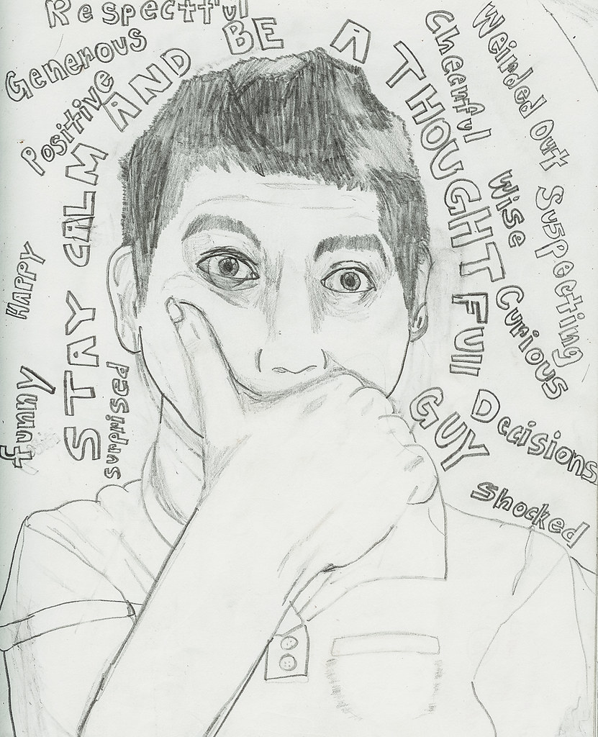
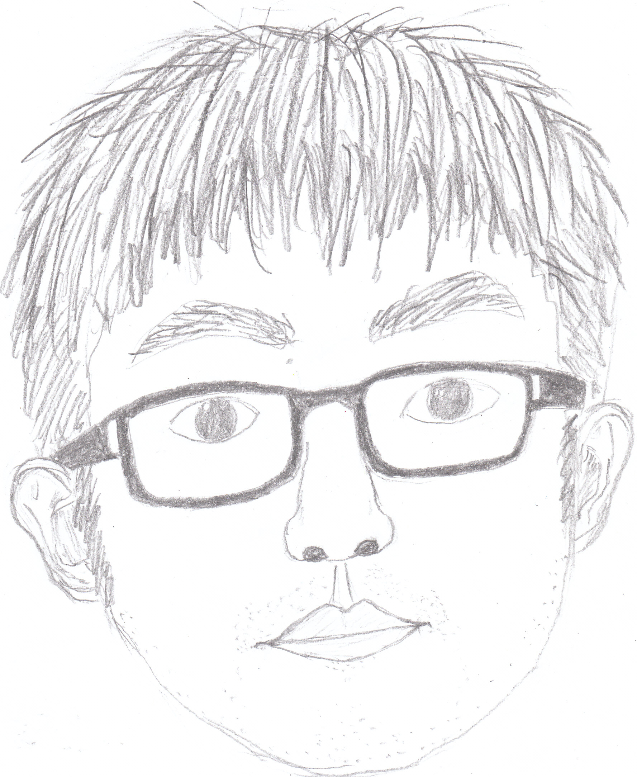
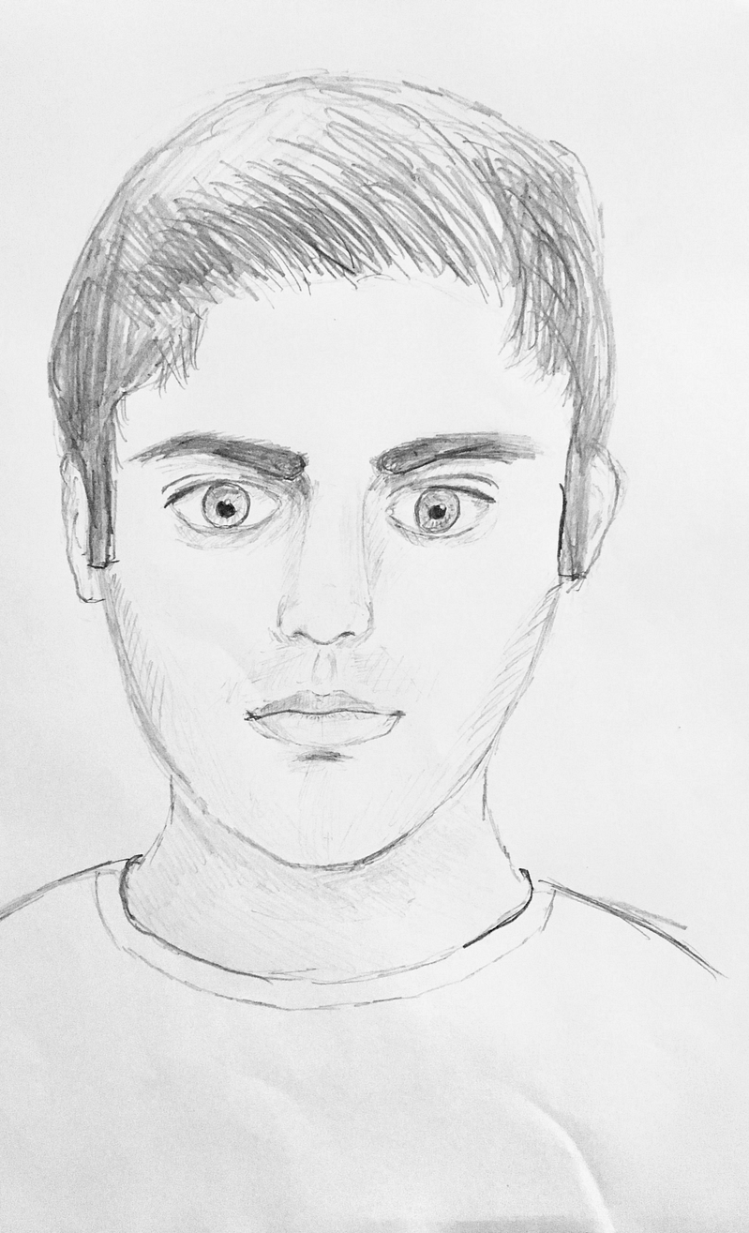
Welcome to UHS Art!
Using whatever pencils/ pens/ colour you have at access to at home, create a self-portrait.
Around the background, write a minimum of 5 GOLD (positive) traits about yourself.

