Slide 1
12.3 Resistance 04/07/2025
DO NOW
Define electric current.
State what electric current is due to.
Name the charge carriers in metals.
State what leads to the electrical properties of metals.
Define potential difference
Define Electromotive force (emf)
Write an equation for electrical power containing potential difference and current
Explain how energy transfers take place in electrical devices.

Slide 2
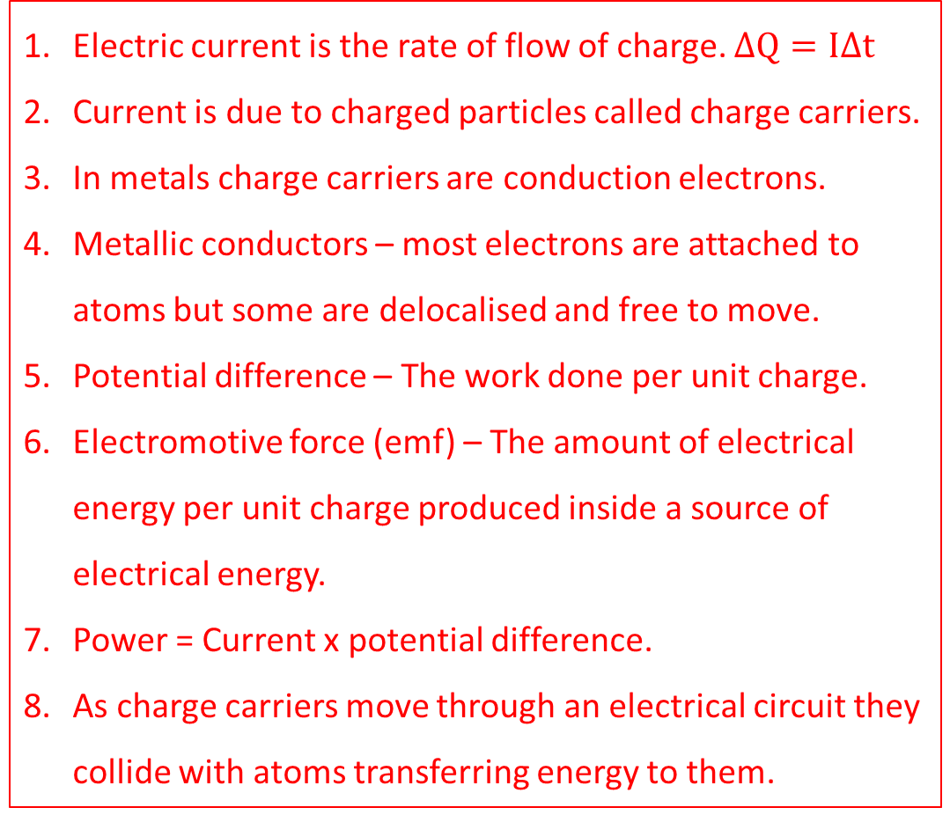
12.3 Resistance
Define electric current.
State what electric current is due to.
Name the charge carriers in metals.
State what leads to the electrical properties of metals.
Define potential difference
Define Electromotive force (emf)
Write an equation for electrical power containing potential difference and current
Explain how energy transfers take place in electrical devices.
Electric current is the rate of flow of charge. $∆Q=I∆t$
Current is due to charged particles called charge carriers.
In metals charge carriers are conduction electrons.
Metallic conductors – most electrons are attached to atoms but some are delocalised and free to move.
Potential difference – The work done per unit charge.
Electromotive force (emf) – The amount of electrical energy per unit charge produced inside a source of electrical energy.
Power = Current x potential difference.
As charge carriers move through an electrical circuit they collide with atoms transferring energy to them.

Slide 3
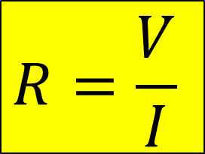
Resistance
Resistance – a measure of how difficult it is for current to flow through a component in a circuit.
Resistance is caused by the collision between charge carriers in a material, with each other, and fixed position positive ions.
$$The resistance of a component=\frac{The Pd across the component}{The current through the component}$$
$$R=\frac{V}{I}$$
The unit of resistance is the Ohm (Ω) and is defined as 1 volt per ampere

Slide 4
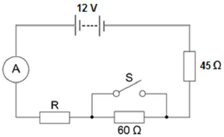
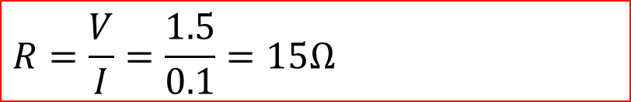
Example
Calculate the resistance of the resistor labelled R, with a current of 0.1A flowing through the circuit.
What happens to the resistance and the current when the switch is closed?
Calculate the potential difference across the known resistors.
$$V_{45}=IR=0.1 x 45=4.5V$$
$$V_{60}=IR=0.1 x 60=6.0V$$
Therefore, the potential difference across R is equal to 1.5V
$$R=\frac{V}{I}=\frac{1.5}{0.1}=15Ω$$
When the switch is closed, the current takes the path of least resistance, and as a result no current flows through the 60 Ohm resistor. The total of the resistance will be reduced from 120 ohms to 60 ohms. The current in the circuit will increase to 0.2 Amperes.

Slide 5
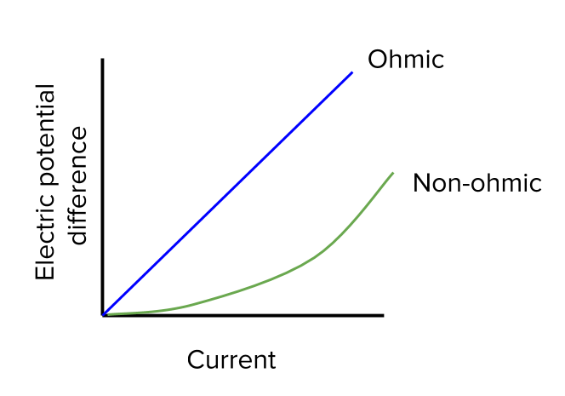
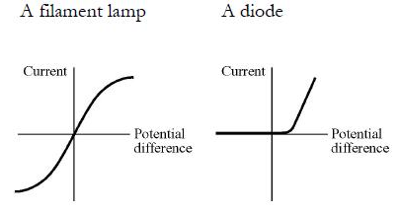
Ohm’s law
Ohm’s law – the potential difference across a metallic conductor is proportional to the current through it, provided the physical conditions do not change.
For an ohmic conductor, V = IR, where the resistance is constant. A resistor is a component designed to provide a certain resistance in a circuit.
For a conductor to be Ohmic, the physical conditions must remain constant, in most cases, this will be the temperature of the component.
If the current and potential difference measured in a circuit are plotted on a graph, with current on the x-axis and potential difference on the y-axis, the gradient of the graph gives the resistance.
Whilst Ohm’s Law is correct for devices under constant conditions, some components increase in temperature when current flows through them. Temperature changes in the components affects the resistance.

Slide 6
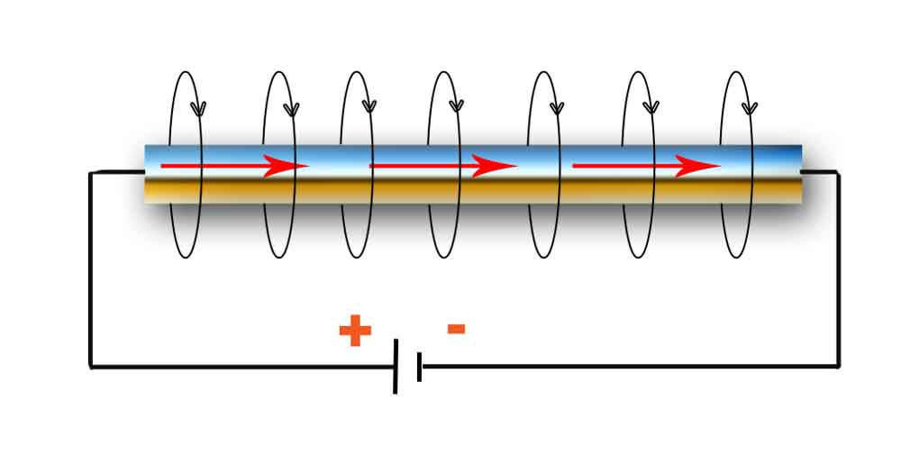

Factor affecting resistance
1) The cross-sectional area
$$Resistance∝\frac{Length}{cross secional area}$$
2) The length
3) The material the wire is made from
The longer the component, the larger the resistance.
The larger the cross-sectional area, the lower the resistance.
The constant of proportionality is called the resistivity.

Slide 7
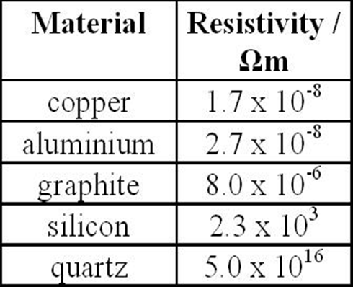
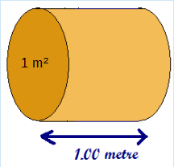

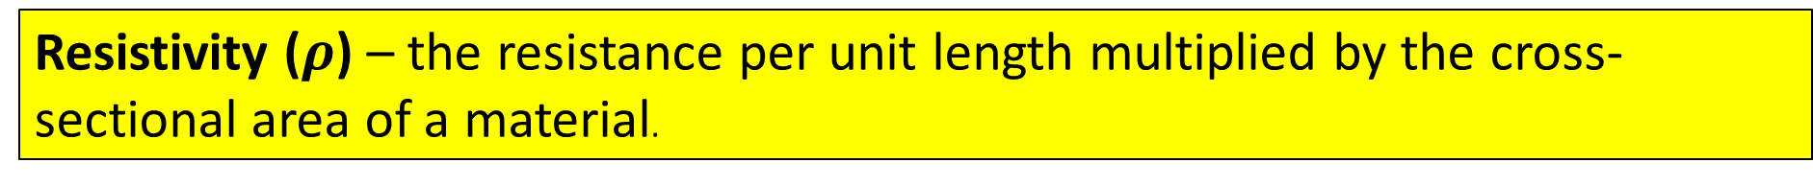
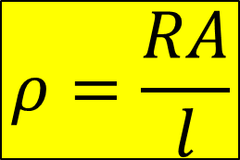
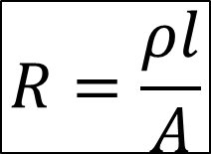
Resistivity
Resistivity ($ρ$) – the resistance per unit length multiplied by the cross-sectional area of a material.
Resistivity is measured in ohm metres (Ω m)
$$Resistance∝\frac{Length}{cross secional area}$$
$$R=\frac{ρl}{A}$$
$$ρ=\frac{RA}{l}$$
The resistivity of a wire can be thought of as the resistance of a metre of wire with a cross sectional area of 1 m²

Slide 8
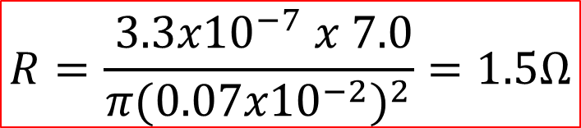
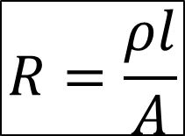
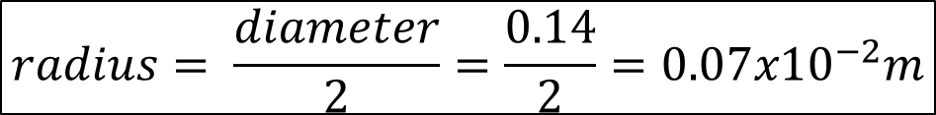
Example
Taking the resistivity of platinoid as${ 3.3x10}^{−7}Ωm$, find the resistance of 7.0m of platinoid wire with an average diameter of 0.14cm.
$$radius= \frac{diameter}{2}=\frac{0.14}{2}={0.07x10}^{−2}m$$
$$Cross−sectional area, A=πr^{2}$$
$$R=\frac{ρl}{A}$$
$$R=\frac{{ 3.3x10}^{−7} x 7.0}{π({{0.07x10}^{−2})}^{2}}=1.5Ω$$

Slide 9
Required activities
You need to cover activities 1-6 for AS and 1-12 for A-level.
Practical 1
Investigation into the variation of the frequency of stationary waves
Practical 2
Investigation of interference effects to include the Young’s slit experiment and interference by a diffraction grating.
Practical 3
Determination of g by a free-fall method.
Practical 4
Determination of the Young modulus by a simple method.
Practical 5
Determination of resistivity of a wire using a micrometer, ammeter and voltmeter.
Practical 6
Investigation of the emf and internal resistance of electric cells and batteries.
Practical 7
Investigation into simple harmonic motion using a mass-spring system and a simple pendulum.
Practical 8
Investigation of Boyle’s (constant temperature) law and Charles’s (constant pressure) law for a gas.
Practical 9
Investigation of the charge and discharge of capacitors.
Practical 10
Investigate how the force on a wire varies with flux density, current and length of wire
Practical 11
Investigate the effect on magnetic flux linkage of varying the angle between a search coil and magnetic field direction.
Practical 12
Investigation of the inverse-square law for gamma radiation.

Slide 10
8.4.2 Common Practical assessment criterial (CPAC) in A-level Physics
In order to be awarded a Pass a student must, by the end of the practical science assessment, consistently and routinely meet the criteria in respect of each competency listed below.
Follows written procedures
Applies investigative approaches and methods when using instruments and equipment
Safely uses a range of practical equipment and materials
Makes and records observations
Researches, references and reports
(a) Correctly follows written instructions to carry out experimental techniques or procedures.
(b) Obtains accurate, precise and sufficient data for experimental and investigative procedures and records this methodically using appropriate units and conventions.
In today’s lesson we are assessing CPAC 1 and CPAC 4b

Slide 11
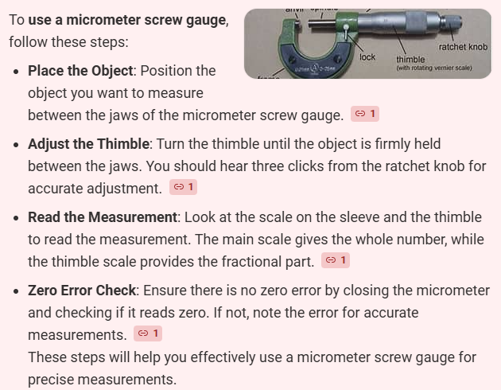
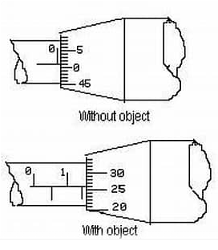
Practical 5
Determination of resistivity of a wire using a micrometer, ammeter and voltmeter.
You will be given equipment to allow you to record results for your practical.
You will be given a partially complete table to record results
You will be given a method to follow.
You must all take measurements during the
practical to show masterary of the CPAC
NEW Skill using a micrometer screw guage
Zero error – subtract 0.1 from your reading
Reading is 1.5 + 0.26 which gives a reading of 1.76, taking into account the zero error is 1.75

