Slide 1

GCSE & A-LEVEL FINE ART PROGRAMME

Slide 2
Q: What does GCSE Fine Art cover?
A: The AQA GCSE Art & Design (Fine Art) course includes:
Drawing, painting, sculpture, printmaking, and mixed media.
Critical studies of artists, movements, and cultures.
Portfolio development (60% coursework) + Externally Set Assignment (40%).
Q: What is the A-Level Fine Art course structure?
A: The AQA A-Level Art & Design (Fine Art) course focuses on:
Advanced techniques (e.g., large-scale painting, digital art, installation).
Personal Investigation (60%) – Portfolio + 3,000-word essay.
Externally Set Assignment (ESA) (40%) – 15-hour practical exam.
Success Spotlight:
Our students’ work is regularly selected by AQA as a national benchmark for grading.
Alumni have progressed to top art schools like UAL, Goldsmiths, and RCA.

Slide 3
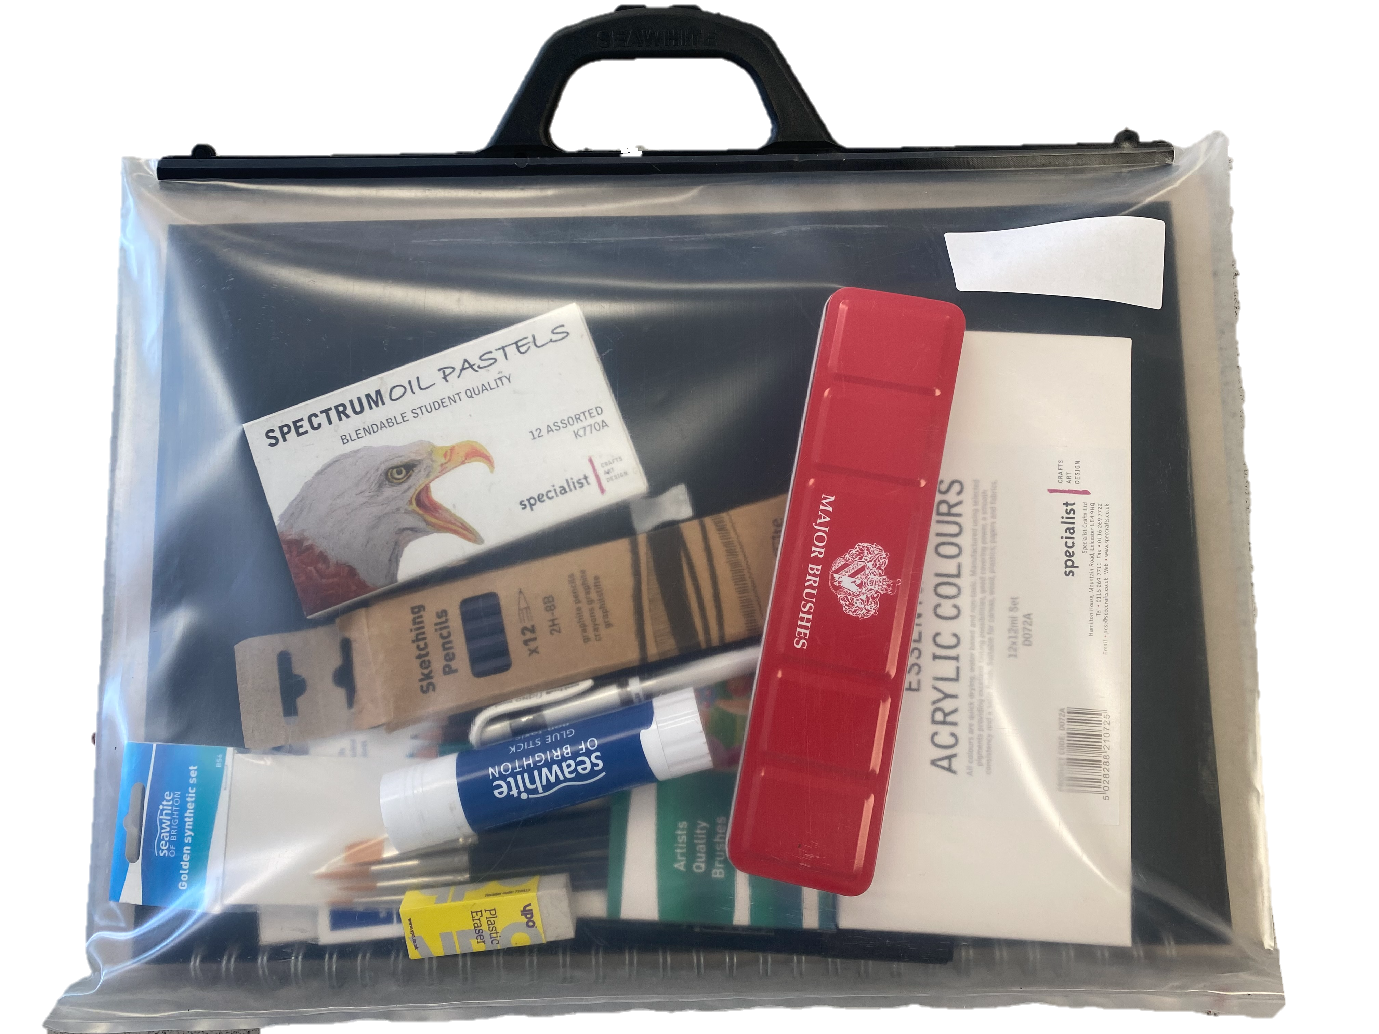
4. Assessment & Exams
Q: How is GCSE Fine Art graded?
60% Portfolio (teacher-assessed, AQA-moderated).
40% ESA (exam project + 10-hour practical exam).
Q: What’s the A-Level Personal Study essay?
A 3,000-word research project linking your artwork to artists/themes.
Q: What materials do I need for the Fine Art course?
To help you get started, the Art Department offers a discounted Art Pack that includes all the essential materials you’ll need. We recommend purchasing this pack through Arbor, where the most up-to-date price will be listed.
Q: What’s included in the Art Pack? GCSE Portfolio
Art folder/ carrier
A3 cartridge sketchbook
A set of soft (B) and hard (H) pencils
Colour pencil set
Oil pastel set
Watercolour set
Paintbrush set
Acrylic paint set
Blending pencil
Double sided tape
Putty rubber, sharpener
White gel pen
Fine liner pen
A Level Portfolio
Art folder/ carrier
A2 or A3 cartridge sketchbook
A set of flat brushes
Oil paint set
Bakers brush
Blending pencil
White gel pen
Fine liner pen
Double sided tape
Putty rubber,
These tools form the foundation of your art practice and are required for classwork, homework, and independent projects.

Slide 4
Q: Can I use other specialist materials?
Absolutely. While the Art Pack covers the basics, students aiming for higher grades or more advanced work are encouraged to explore professional art materials. These often offer superior performance, richer colours, and more refined results, especially useful when experimenting with techniques or building a portfolio.
Recommended specialist brands include:
Winsor & Newton
Daler-Rowney
Cotman (by Winsor & Newton)
Faber Castell
Staedtler
Caran d’Ache
These brands are known for their high-quality materials and are used by art students and professionals alike.
Q: Why use specialist materials?
Using quality materials:
Enhances your ability to experiment and refine your technique
Supports stronger, more vibrant final outcomes
Gives your work a more professional edge — essential for GCSE and A-level portfolios
If you're interested in expanding your kit, speak to your art teacher for advice on what to prioritise based on your interests (e.g. painting, illustration, mixed media).
Q: Careers & Higher Education
Career Paths: Illustrator, Art Therapist, Architect, Gallery Curator, Animator.
Top Destinations:
University of the Arts London (UAL)
Goldsmiths, University of London
The Glasgow School of Art

Slide 5
Glossary
ESA: Externally Set Assignment (exam project).
Personal Study: A-Level essay + artwork analysis.
Portfolio: Curated body of work for assessment.
8. Support & Contacts
Key Staff:
Mr. Sasu (Curriculum Leader) – esasu@uhs.org.uk
Ms. Besze (Teacher) – dbesze@uhs.org.uk
Ms. Cumplen (Technician) – jcumplen@uhs.org.uk

Slide 6
Project
AQA A Level Art, Craft and Design Specification https://www.aqa.org.uk/subjects/art-and-design/as-and-a-level/art-and-design-7201/subject-content/art,-craft-and-design AQA A Level Fine Art Specification https://www.aqa.org.uk/subjects/art-and-design/as-and-a-level/art-and-design-7201/subject-content/fine-art AQA A Level Art Mark Scheme https://filestore.aqa.org.uk/resources/art-and-design/AQA-AS-A-ART-TG-GUIDE.PDF
Statement of Intent https://www.bbc.co.uk/bitesize/guides/z83g8mn/video https://www.bbc.co.uk/bitesize/guides/z83g8mn/revision/1
Mind Map: https://www.youtube.com/watch?v=0qG613IG-kc
Primary and Secondary Images/ Sources https://www.youtube.com/watch?v=RQ8xYYB9dm4 https://www.bbc.co.uk/bitesize/guides/zwk82nb/revision/2
Artist Analysis https://www.youtube.com/watch?v=0h8k5-DDJlg https://www.studentartguide.com/articles/how-to-analyze-an-artwork https://www.bbc.co.uk/bitesize/guides/zymtv9q/revision/1 https://theartyteacher.com/good-examples-of-artist-research-pages/
Annotation https://www.studentartguide.com/articles/how-to-annotate-a-sketchbook https://www.bbc.co.uk/bitesize/guides/zgtngdm/revision/1 https://www.bbc.co.uk/bitesize/guides/zgtngdm/video
Personal Investigation Essay https://www.youtube.com/watch?v=o1oloV0fRWg&t=41s

